Slide 1



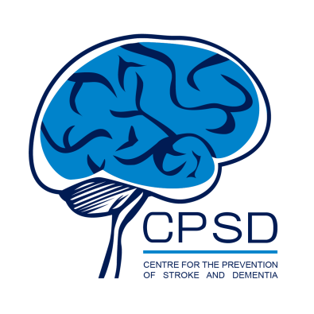





Regional diffusion imaging changes related to obesity after adjusting for other risk factors: the UK Biobank study
Karolina Wartolowska & Alastair Webb
Wolfson Centre for Prevention of Stroke and Dementia
Nuffield Department of Clinical Neurosciences
University of Oxford, Oxford, UK
karolina.wartolowska@ndcn.ox.ac.uk @KAWartolowska www.ka-wa.io

Slide 2
Disclosures
Dr Karolina Wartolowska has no conflicts of interest to disclose.
Wartolowska ISMRM 2022

Slide 3
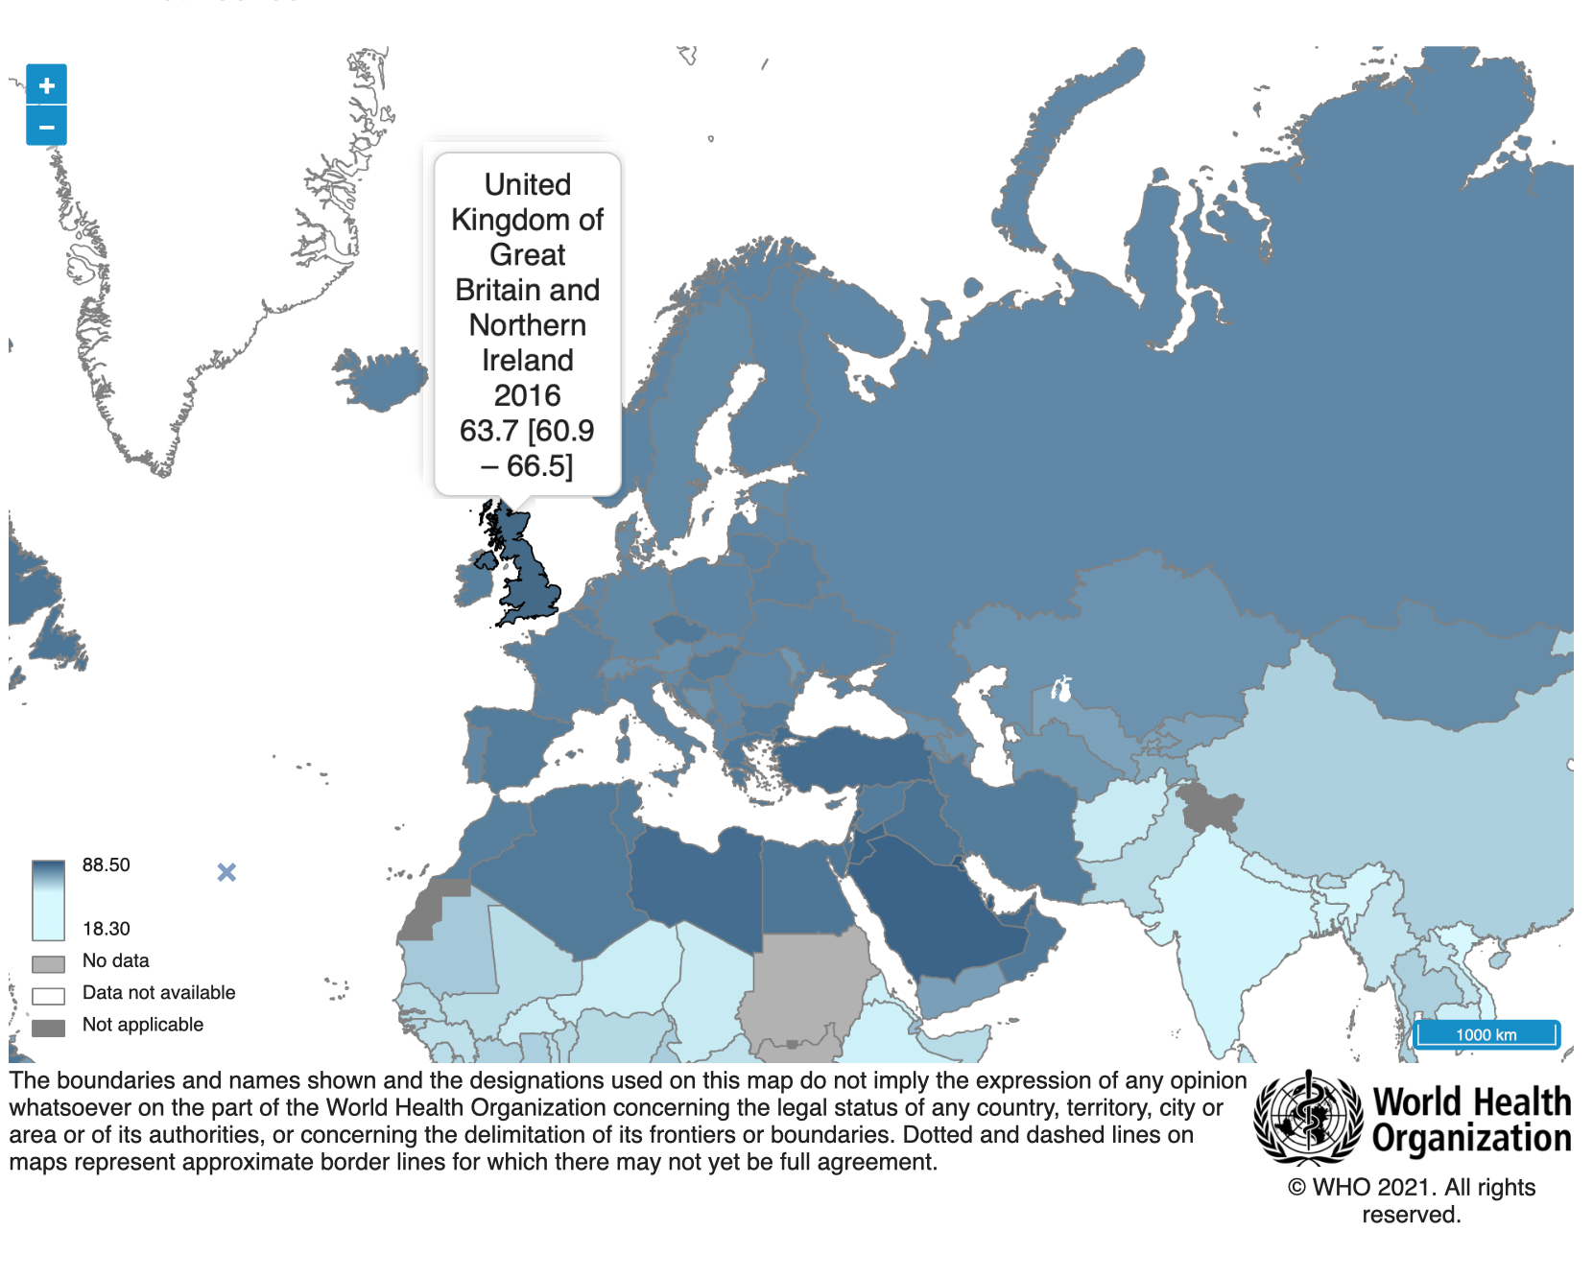
Background
Cerebral small vessel disease is a common cause of white matter damage in older people. It is strongly associated with age, hypertension, smoking, diabetes, and obesity.
In the UK, 27% of adults are obese and 64% are overweight.
Wartolowska ISMRM 2022

Slide 4
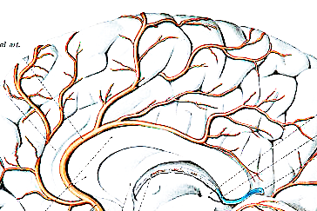
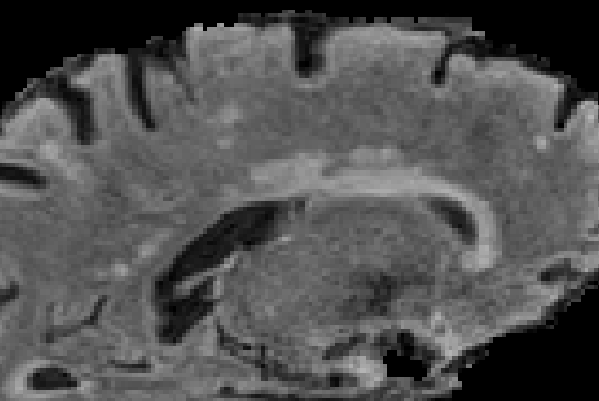
Background
Cerebral small vessel disease damages small vessels and surrounding brain tissue.
White matter injury is evident on structural MRI as white matter hyperintensities, but the disease also affects white matter that appears normal, and these microstructural changes can be quantified using diffusion imaging (dMRI).
Wartolowska ISMRM 2022
Notes:
A medical illustration from 'Atlas and Text-book of Human Anatomy' (by Dr. Johannes Sobotta) shows the arteries of the mesial surface of the cerebrum and of the surface of the cerebellum, 1911.

Slide 5
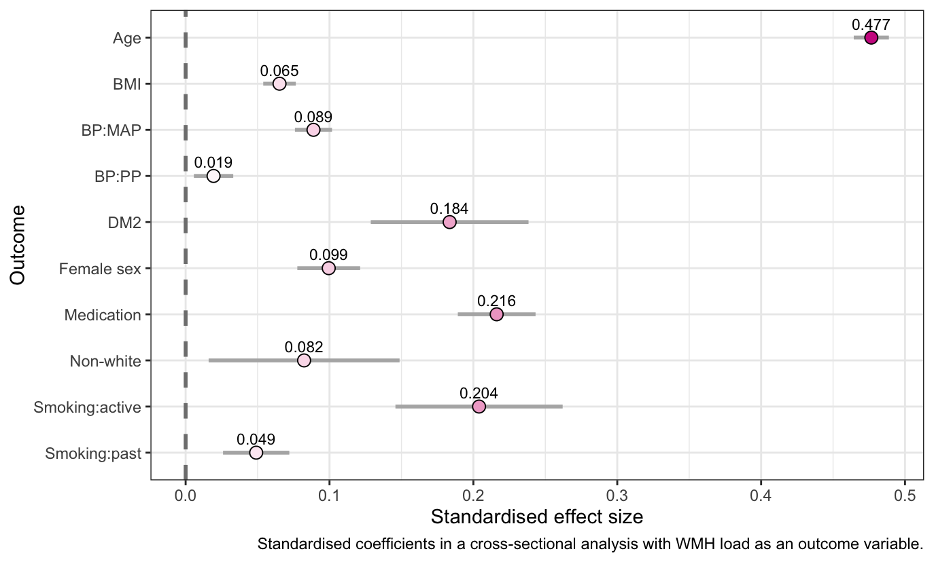
RESULTS
Associations between white matter hyperintensity load and risk factors
Wartolowska ISMRM 2022

Slide 6
Aims
The aim of this study was to investigate the effect of being overweight, as estimated using the body mass index (BMI), on microstructural white matter damage assessed using dMRI and the interactions between the BMI and blood pressure.
Wartolowska ISMRM 2022

Slide 7

Methods
Data: UK Biobank is a prospective cohort of 502,413 community-based people, 37-73 years old at recruitment; brain MRI data available for 45,877.
dMRI measures, both DTI and NODDI: fractional anisotropy (FA)
mean diffusivity (MD)
intracellular volume fraction (ICVF)
isotropic volume fraction (ISOVF)
orientation dispersion (OD)
Wartolowska ISMRM 2022
Notes:
neurite orientation dispersion and density imaging

Slide 8
Methods
All predictors were standardised before modelling.
The associations between dMRI within each of the 27 white matter tracts
were analysed using mixed-effects models with fixed effects for BMI, age, sex, mean arterial blood pressure, pulse pressure, source of blood pressure measurement, smoking, diabetes, antihypertensive medication, and location of the tract within the cerebral circulation; and with random intercepts for the white matter tract and participant.
Wartolowska ISMRM 2022
Notes:
neurite orientation dispersion and density imaging

Slide 9
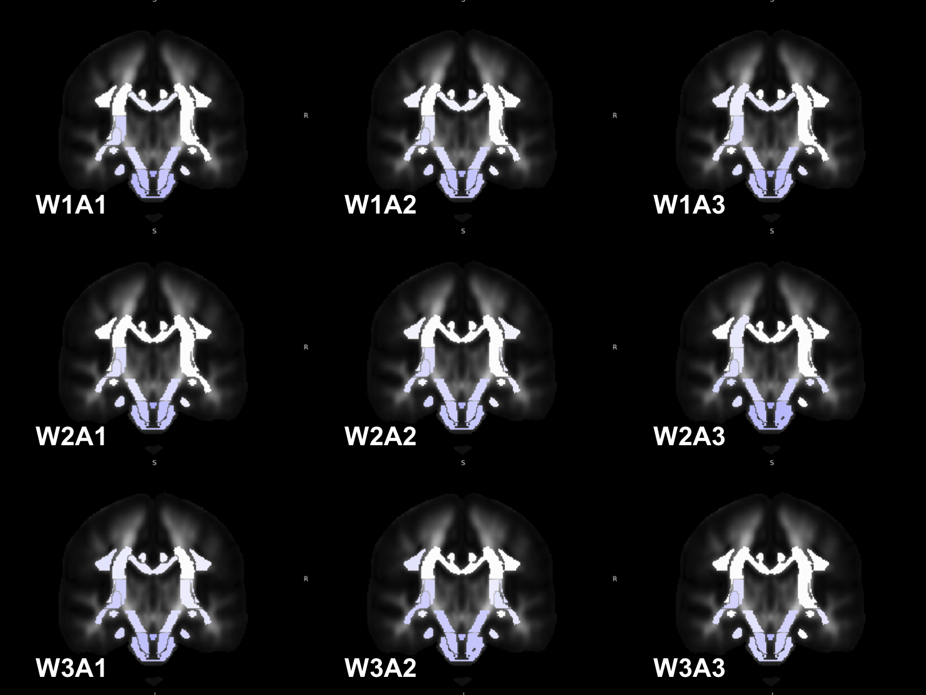
Results
Associations between mean diffusivity (MD) and BMI in each white matter tract,
in a fully-adjusted model.
Stratified by tertials of age (A1 to A3) in each column and tertials of white matter hyperintensity (W1-W3) in each row.
Wartolowska ISMRM 2022

Slide 10
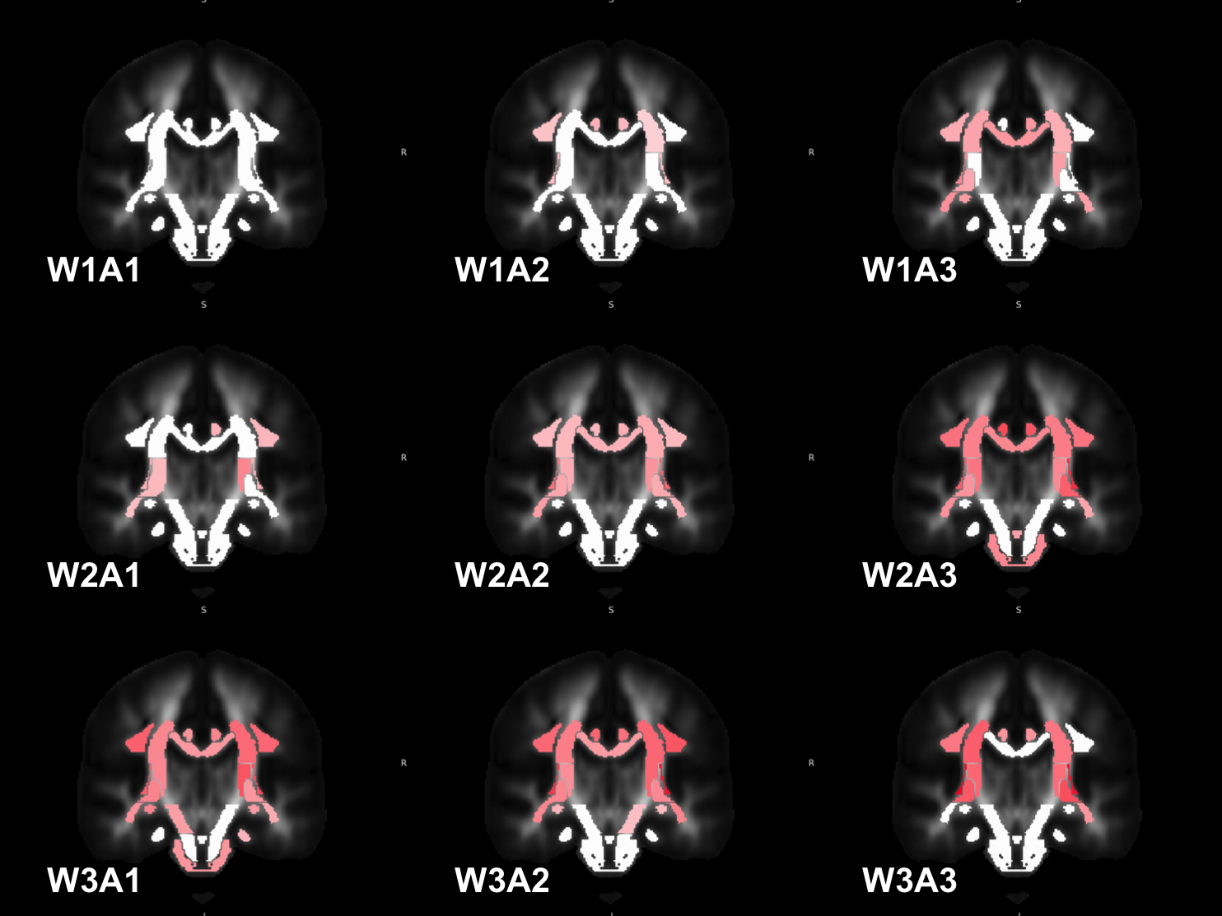
Results
Associations between mean diffusivity (MD) and PP in each white matter tract,
in a fully-adjusted model.
Stratified by tertials of age (A1 to A3) in each column and tertials of white matter hyperintensity (W1-W3) in each row.
Wartolowska ISMRM 2022

Slide 11
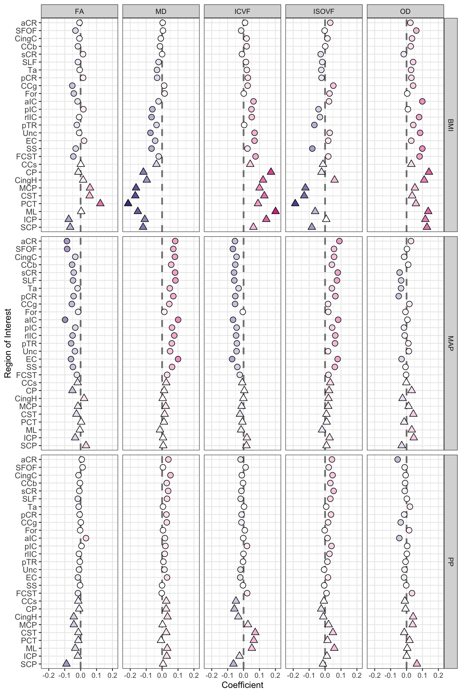
Wartolowska ISMRM 2022
Notes:
this is the effect of the BMI variable (per standardised unit) in a fully-adjusted model for each of the five measures – columns and white matter tracts (rows)

Slide 12
Wartolowska & Webb. Journal of Cerebral Blood Flow and Metabolism. 2022;42:802–810.

Slide 13
Wartolowska ISMRM 2022

Slide 14
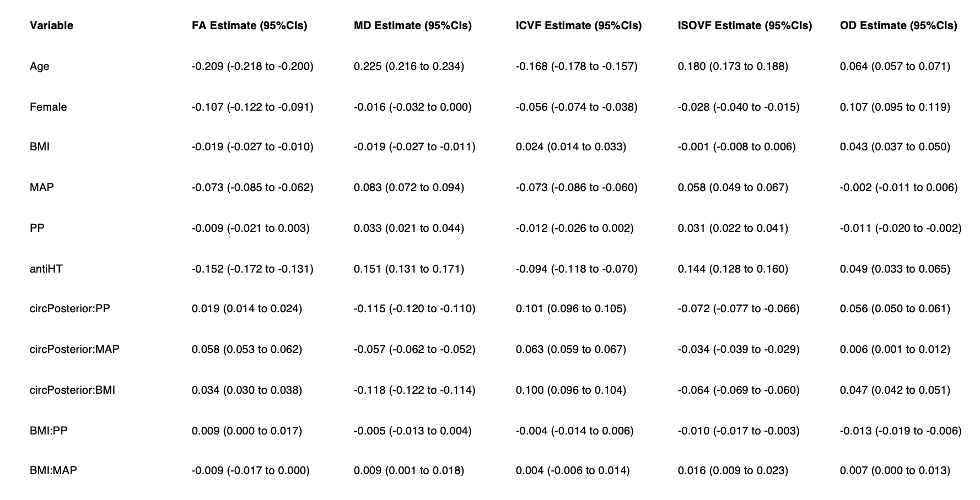
Results

Slide 15
RESULTS
Conclusions
Obesity is an independent risk factor for white matter damage.
The effect of obesity is stronger in the posterior circulation.
The relationships between obesity, blood pressure, and microstructural white matter injury are complex.
Wartolowska ISMRM 2022

Slide 16
RESULTS

